Slide 1

Diamond price prediction

Slide 2
Agenda
Data pre-processing and Building model
About Dataset
EDA

Slide 3

Introduction
The goal of this regression project is to predict diamond prices accurately. By analyzing historical data on diamonds with known prices and their characteristics, we will develop a regression model. The model will consider factors such as carat weight, cut quality, color grade, and clarity grade to make accurate price predictions. We will explore various regression algorithms, evaluate their performance, and optimize the model through feature engineering. The success of the project will be measured by predictive accuracy and interpretability

Slide 4

Topic one
About Dataset

Slide 5
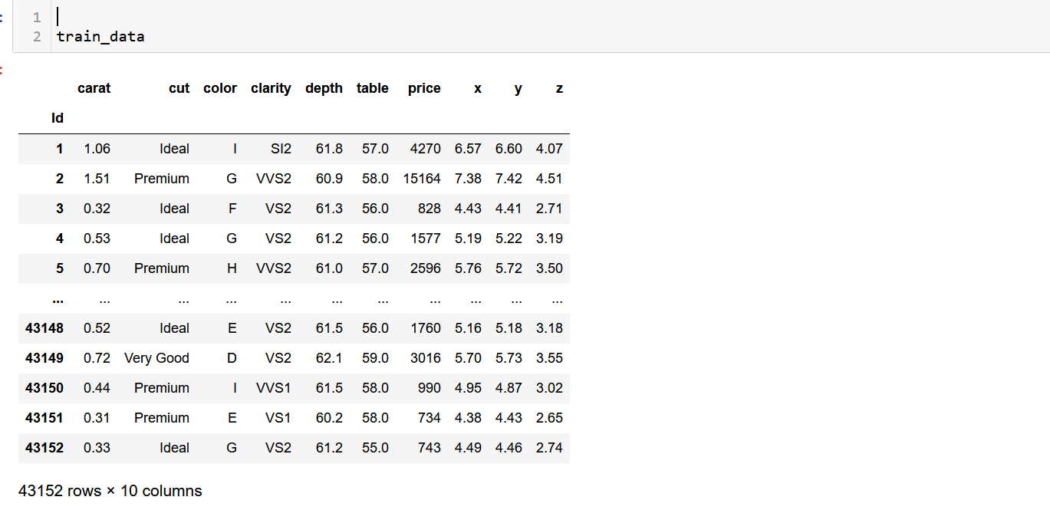
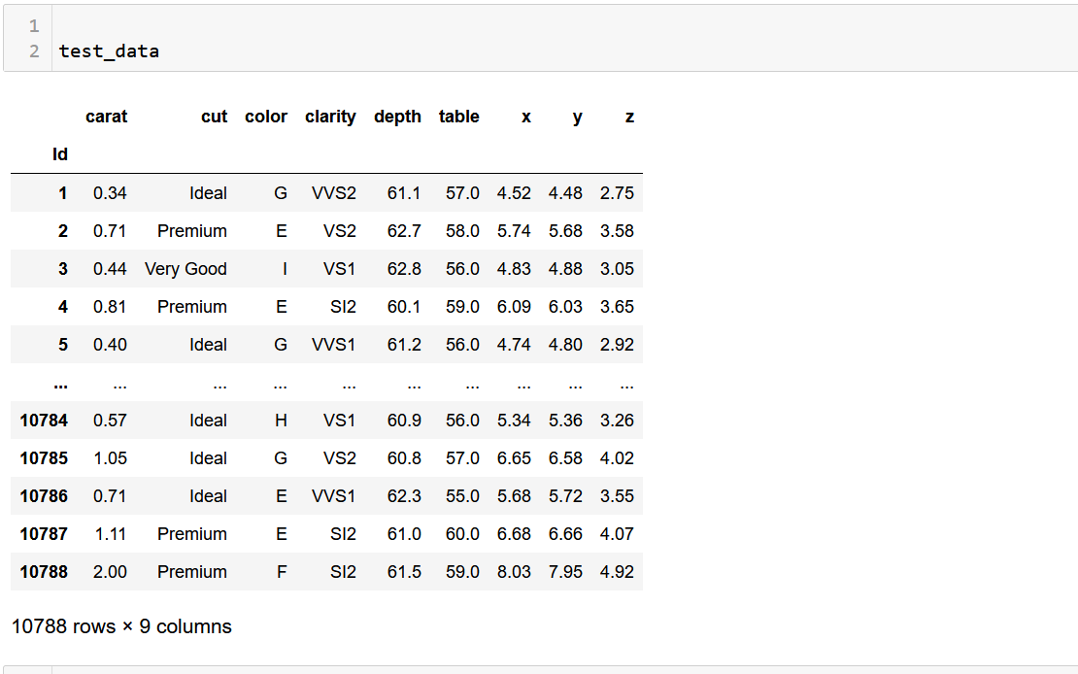
About dataset
This dataset consists of two distinct subsets: a training dataset dedicated to model construction and a separate test dataset specifically designed to evaluate the model's predictive accuracy.
Within this dataset, we have meticulously compiled a range of attributes that encapsulate the essential characteristics of diamonds. Let us explore these attributes further:
Carat Weight: The weight of the diamonds, expressed in carats, holds substantial influence over their price valuation. This attribute serves as a fundamental factor in our predictive model.
Cut Quality: The dataset includes a column representing the quality of each diamond's cut. As we know, the cut quality plays a pivotal role in determining a diamond's brilliance and overall visual appeal.
Color Grade: Diamonds are meticulously graded on a color scale ranging from D (colorless) to Z (yellow or brown). The dataset provides us with the color grade assigned to each diamond, enabling us to consider its impact on price.
Clarity Grade: The presence of internal or external flaws in a diamond is denoted by its clarity grade, which ranges from Internally Flawless (IF) to Included (I3). This attribute plays a crucial role in assessing the value of each diamond.
Depth Percentage: By examining the ratio of a diamond's depth to its average diameter, we can gain valuable insights into its proportions and the way it interacts with light. This attribute contributes significantly to our understanding of a diamond's visual allure.
Table Percentage: The width of a diamond's top facet (table) relative to its average diameter is captured in the table percentage column. This characteristic holds significance in determining the diamond's visual impact and the manner in which light is refracted.
In addition to these core attributes, our dataset encompasses further dimensions such as length, width, height.

Slide 6
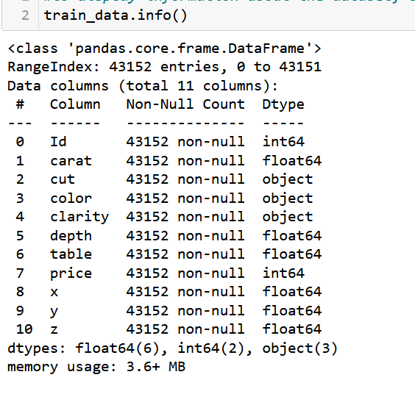
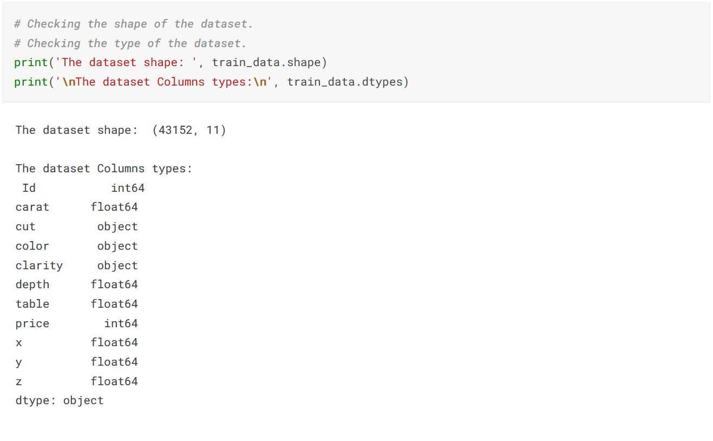
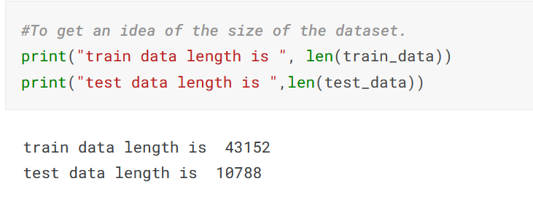
About dataset
Used shape,len and info to give an insight about the data size, number of columns and rows , type that was used and to check if there is null

Slide 7

Topic two
EDA analysis

Slide 8
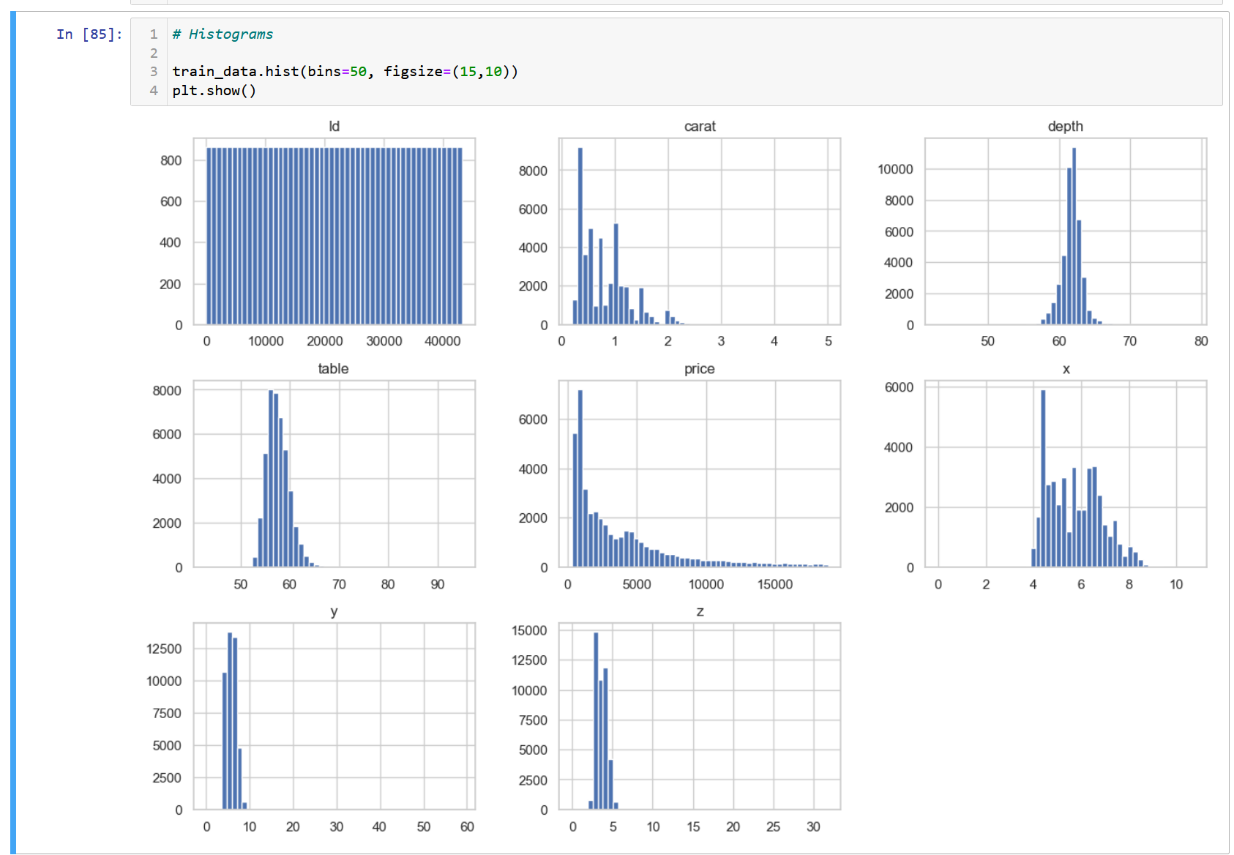
visualization
used train_data.hist() to know how the values of the attribute is distributed
The histograms reveal interesting insights about the data. Firstly, the 'carat' column exhibits a skewed right distribution, indicating that a majority of diamonds have a weight of less than 1 carat. Moving on to the 'depth' column, the distribution appears to be roughly normal, but there are noticeable outliers above 70 degrees. In contrast, the 'table' column displays a bimodal distribution, with one peak centered around 53 degrees and another around 60 degrees. Lastly, the 'price' column demonstrates a skewed right distribution, suggesting that most diamonds in the dataset are priced below $10,000. These observations provide valuable information about the characteristics and pricing trends of the diamonds.

Slide 9
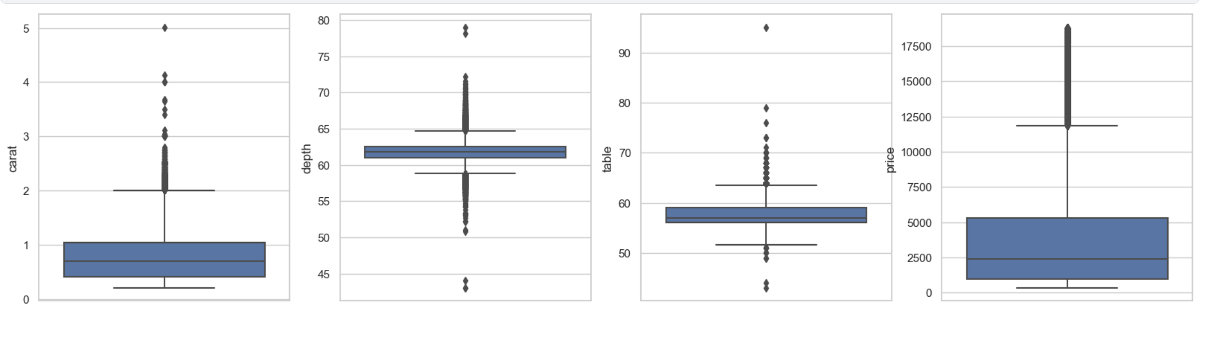
visualization
Used boxplot to get to see the outliers on the dataset
The box plots provide insightful observations about the data distribution. Starting with the 'carat' column, it is notable that there are several outliers above 3 carats, indicating the presence of larger and potentially rarer diamonds in the dataset. Moving on to the 'depth' column, the median value of approximately 62 degrees suggests that the majority of diamonds have a depth around this value. However, there are also outliers above 70 degrees, suggesting the existence of diamonds with unusually high depth measurements. Similarly, in the 'table' column, the median value of around 57 degrees indicates that most diamonds have a table measurement around this range. However, outliers above 70 degrees suggest the presence of diamonds with larger table sizes. Lastly, in the 'price' column, there are several outliers exceeding $15,000, suggesting the existence of high-priced diamonds in the dataset. These observations shed light on the characteristics and potential variations in carat, depth, table, and price among the diamonds.

Slide 10
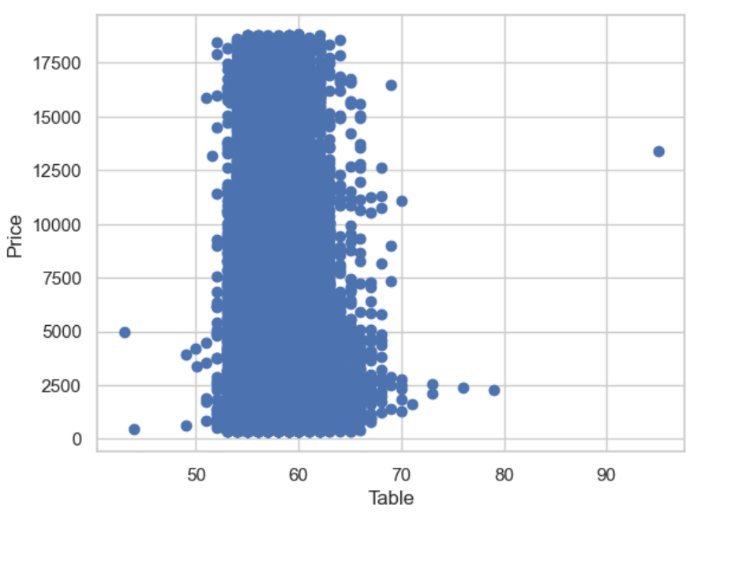
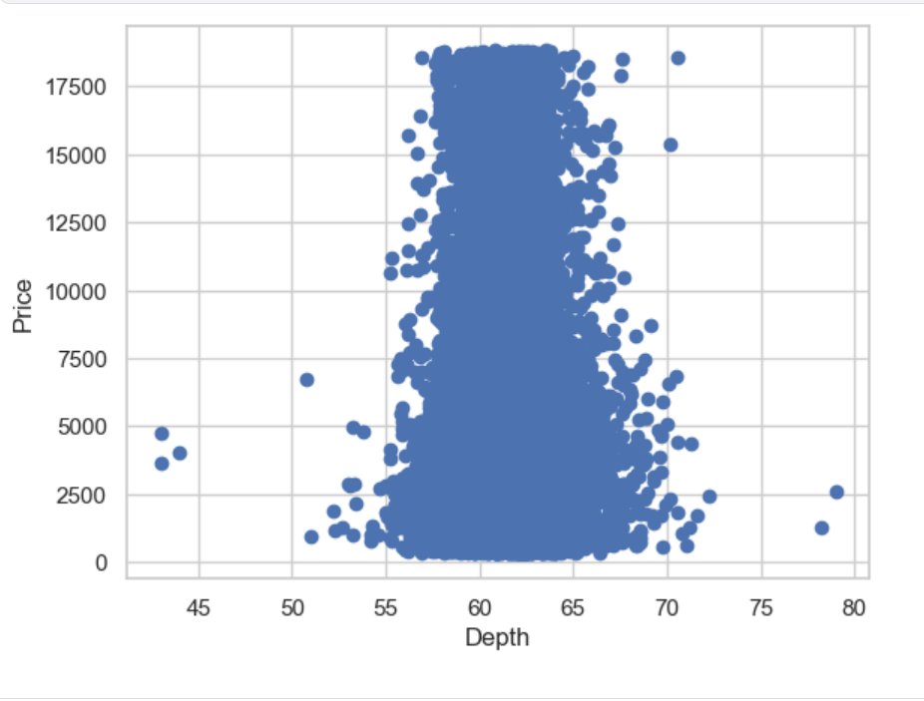
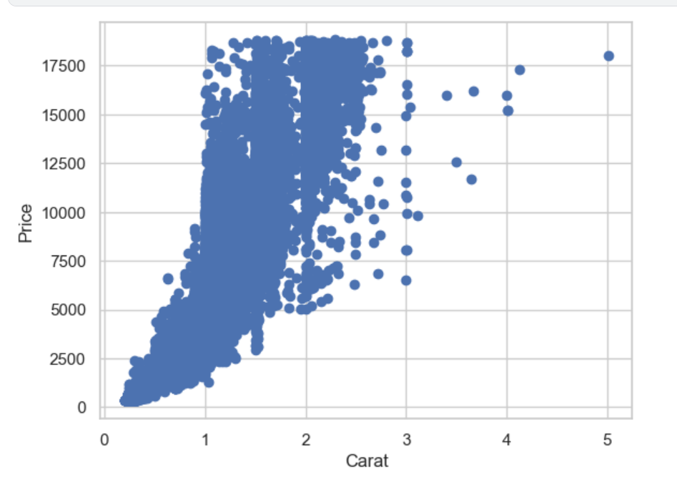
visualization
used scatter to get a closer look on the correlation between attribute( Carat, Depth, Table ) and price
The scatterplot provides valuable insights into the relationships between various variables. Firstly, when examining the relationship between carat and price, a positive correlation becomes evident. This finding aligns with expectations, as carat serves as a measure of diamond size, and larger diamonds tend to be more expensive.
In contrast, the scatterplot of table versus price does not exhibit a clear relationship between the two variables. The points appear to overlap significantly, indicating a lack of a distinct trend or correlation.
Similarly, when considering the depth and table variables in relation to the price variable, no strong correlation can be observed. The scatterplot fails to reveal any notable patterns or trends in this regard.

Slide 11
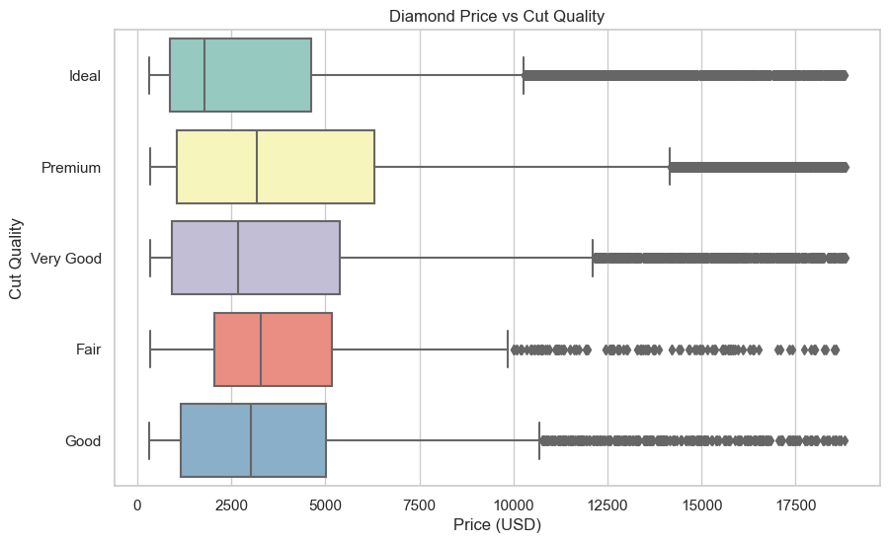
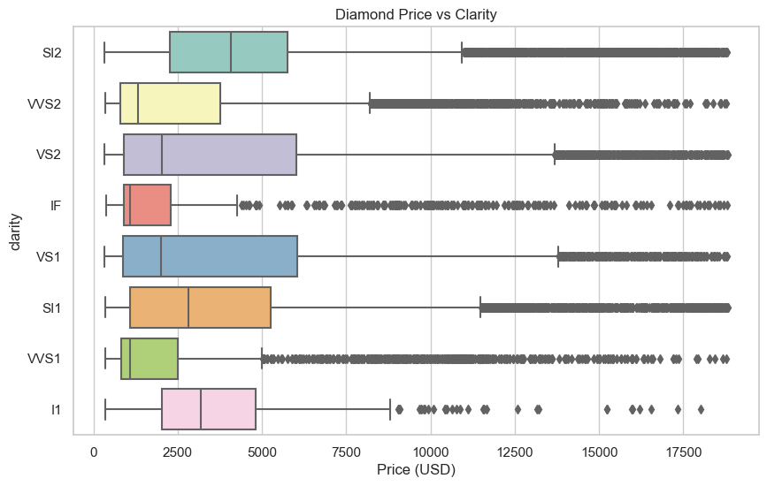
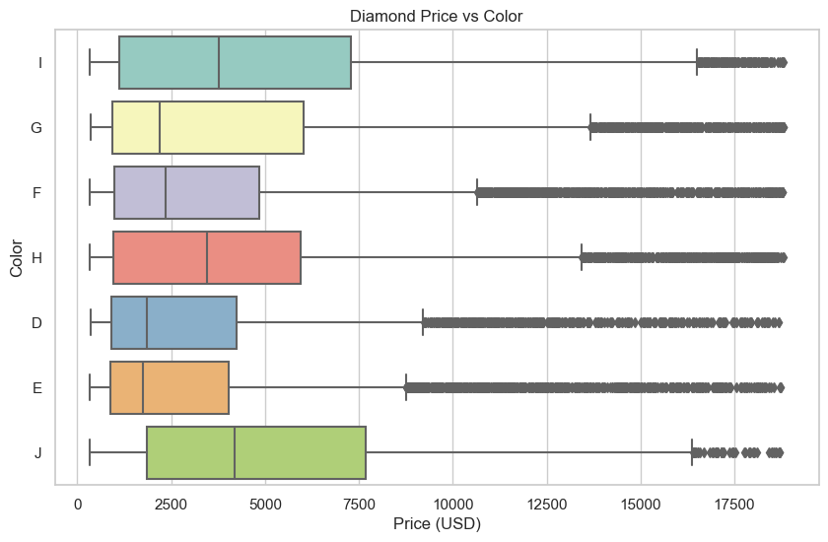
visualization
Used boxplot with categorical data to show relationship between them and price
The box plots provide valuable insights into the relationship between diamond prices and factors such as the quality of the cut, color, and clarity. It is evident that as these quality factors improve, the price of diamonds tends to increase. This finding aligns with expectations, as higher quality attributes are typically associated with greater value in the diamond market.
Overall, the box plots provide a comprehensive view of how different quality factors impact diamond prices, allowing for a better understanding of the pricing dynamics within the diamond industry.

Slide 12
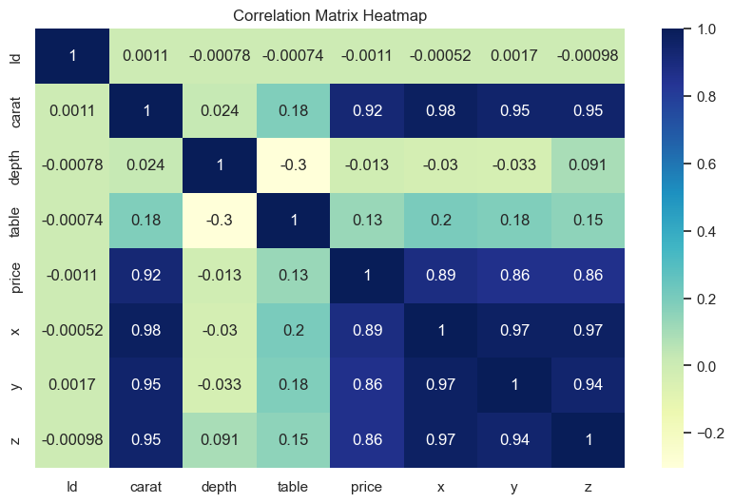
visualization
Used heatmap to the correlation between all the features we have
The box plots provide valuable insights into the relationship between diamond prices and factors such as the quality of the cut, color, and clarity. It is evident that as these quality factors improve, the price of diamonds tends to increase. This finding aligns with expectations, as higher quality attributes are typically associated with greater value in the diamond market.
Overall, the box plots provide a comprehensive view of how different quality factors impact diamond prices, allowing for a better understanding of the pricing dynamics within the diamond industry.

Slide 13

Topic three
Data pre-processing and Building model

Slide 14
Data pre-processing and Building model
Data Preprocessing and Model Building Steps:
The data preprocessing steps involved in the analysis of the diamonds dataset are as follows. Firstly, the 'volume' feature was calculated by multiplying the 'x', 'y', and 'z' dimensions of the diamonds, providing a measure of their overall size. Outliers were then removed from the 'carat' and 'price' columns to eliminate extreme values. Categorical features ('cut', 'clarity', 'color') were encoded using an ordinal encoding scheme, ensuring meaningful numerical representation. A ColumnTransformer was employed to apply specific preprocessing techniques to different columns, including ordinal encoding for categorical features and mean imputation for missing values in numeric features.
The model building process involved creating a pipeline that integrated the preprocessing steps, feature scaling using StandardScaler, and a RandomForestRegressor. The pipeline ensured a streamlined workflow for the data, feature transformation, and model training. Hyperparameters for the RandomForestRegressor, such as the number of estimators, maximum depth, and minimum samples split, were specified in a hyperparameter grid to optimize model performance. The data was split into training and validation sets using train_test_split, and the model was evaluated on the validation data using root mean squared error (RMSE). Finally, the trained model was used to predict prices for the test data.

Slide 15
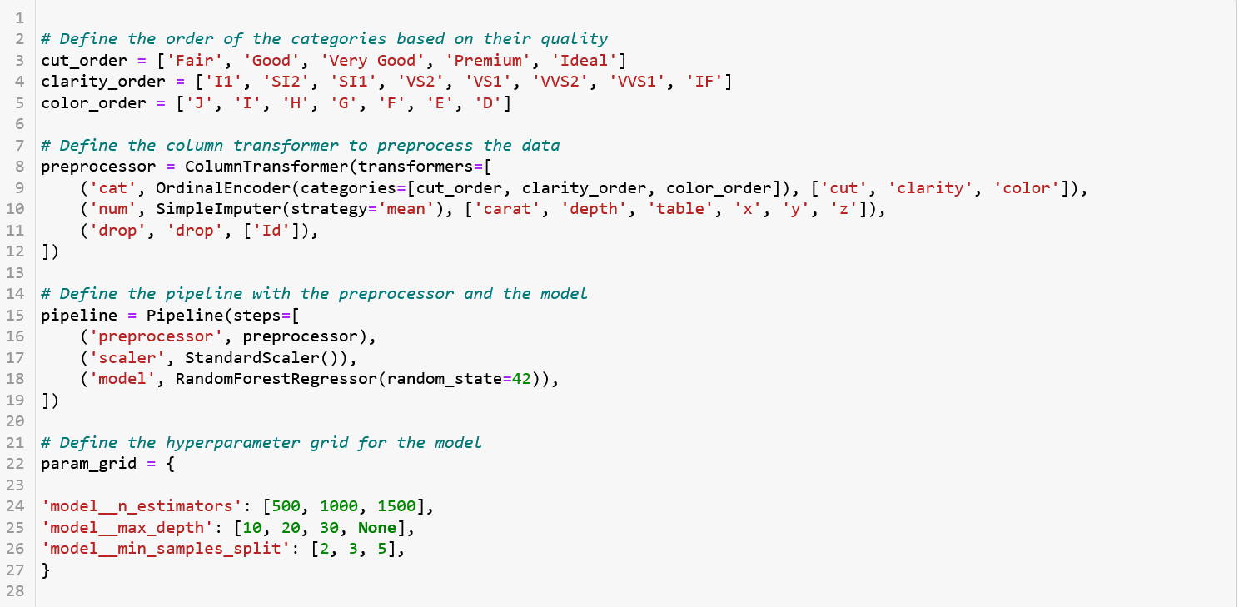
In this code, we are preparing the data for a regression task using a random forest model. First, we define the order of categories based on their quality, such as the cut quality, clarity grade, and color grade. Then, we set up a column transformer, which applies different preprocessing steps to different columns of the data. The transformer includes an ordinal encoder to convert the categorical columns ('cut', 'clarity', 'color') into ordinal integers based on the specified category order. It also includes a simple imputer that replaces missing values in numerical columns ('carat', 'depth', 'table', 'x', 'y', 'z') with the mean of each column. Additionally, we drop the 'Id' column from the data. Next, we create a pipeline that combines the preprocessor with additional steps. The pipeline starts with the preprocessor we defined earlier, followed by a standard scaler that standardizes the numerical features by subtracting the mean and scaling to unit variance. The final step in the pipeline is a random forest regressor model with a random state of 42 for reproducibility. To optimize the model's performance, we define a hyperparameter grid that specifies the range of values to search for the best combination of hyperparameters. It includes parameters such as the number of estimators (trees) in the random forest, the maximum depth of the trees, and the minimum number of samples required to split an internal node. By setting up the column transformer, pipeline, and hyperparameter grid, we are now ready to preprocess the data, train the model, and find the best hyperparameters using techniques like grid search and cross-validation.

Slide 16
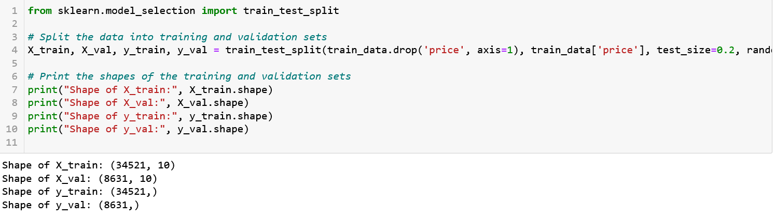
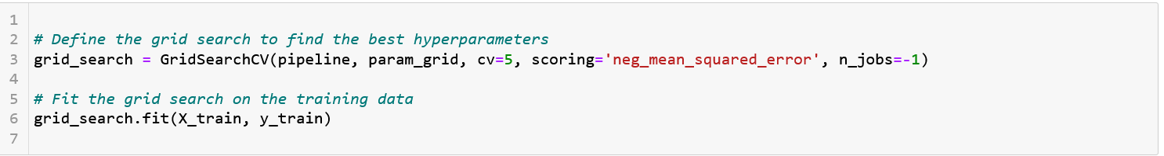
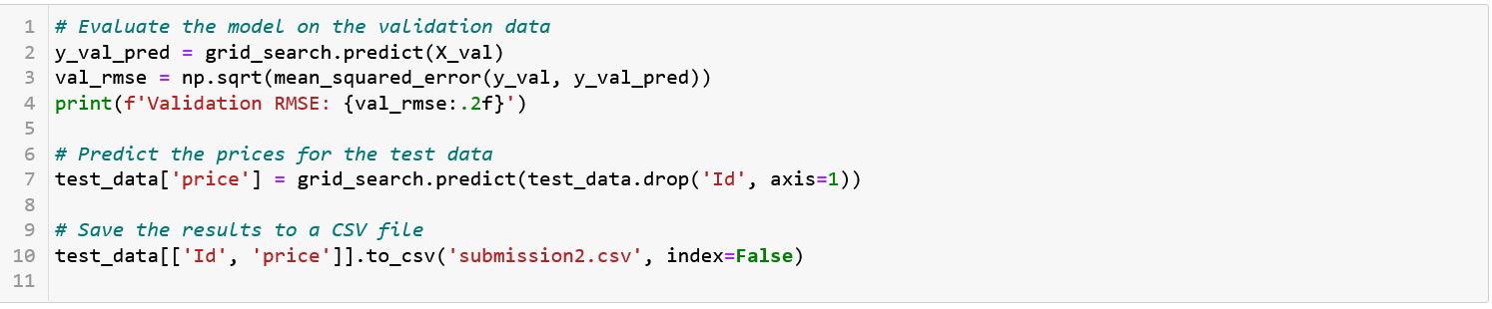
In This code we tried to evaluates the trained model on the validation data by predicting the target variable (y_val_pred) using the predict method of the grid search object (grid_search). then calculates the root mean squared error (RMSE) between the predicted values and the actual values (y_val) using the mean_squared_error function from scikit-learn. Then , the model is used to predict the prices for the test data. The predicted prices are obtained by calling the predict method of the grid search object on the test data (test_data.drop('Id', axis=1)), and the results are stored in the 'price' column of the test_data DataFrame.
Finally, the results, including the 'Id' and 'price' columns, are saved to a CSV file named 'submission.csv' using the to_csv function.
In this code we splits the data into training and validation sets using the train_test_split function from scikit-learn.
It then prints the shapes of the resulting sets for verification.
In this code, we're using a technique called grid search to fine-tune the hyperparameters of our model.
The grid search systematically explores different combinations of hyperparameter values defined in the param_grid.
We create a GridSearchCV object, which takes our model pipeline, the parameter grid, and other settings such as cross-validation (cv=5) and scoring metric (neg_mean_squared_error).
The grid search then fits this object to our training data (X_train and y_train), evaluating each combination of hyperparameters using cross-validation and the specified scoring metric.
By the end of this process, we'll have determined the best hyperparameter values that yield the lowest mean squared error. I
t's an effective way to optimize our model's performance without manually adjusting hyperparameters.

Slide 17
Summary
In this project, we aimed to predict the prices of diamonds based on various attributes. The dataset included features such as carat weight, cut quality, color grade, clarity grade, and dimensions of the diamonds.
To preprocess the data, we calculated the volume of each diamond by multiplying its length, width, and depth. Outliers were removed from the carat and price columns to ensure data integrity. Categorical features were encoded using an ordinal encoding scheme, and missing values in numeric features were imputed with the mean.
Next, we built a predictive model using a Random Forest Regressor. The model was trained on the preprocessed data using a pipeline that incorporated feature scaling and the defined preprocessing steps. Hyperparameter tuning was performed to optimize the model's performance, considering parameters such as the number of estimators, maximum depth, and minimum samples split.
The model's accuracy and performance were assessed using a validation set, and the root mean squared error (RMSE) was calculated as an evaluation metric. The trained model was then used to predict diamond prices for the test dataset.
Overall, this project demonstrated the process of data preprocessing, model building, and prediction for diamond price estimation. By leveraging machine learning techniques, we were able to develop a model that accurately predicts diamond prices based on their characteristics, providing valuable insights for the diamond industry.

Slide 18
Team
Yasmin Hammad
Maysam

Slide 19
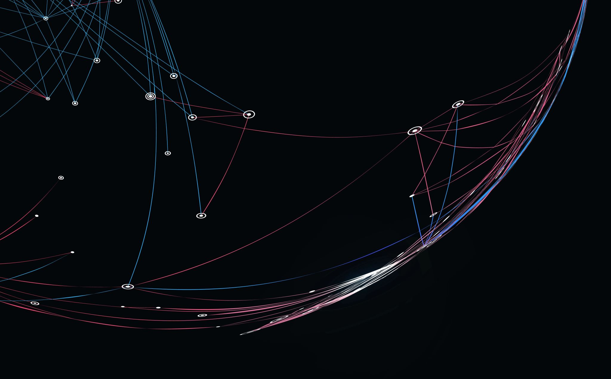
Thank you

